Slide 1


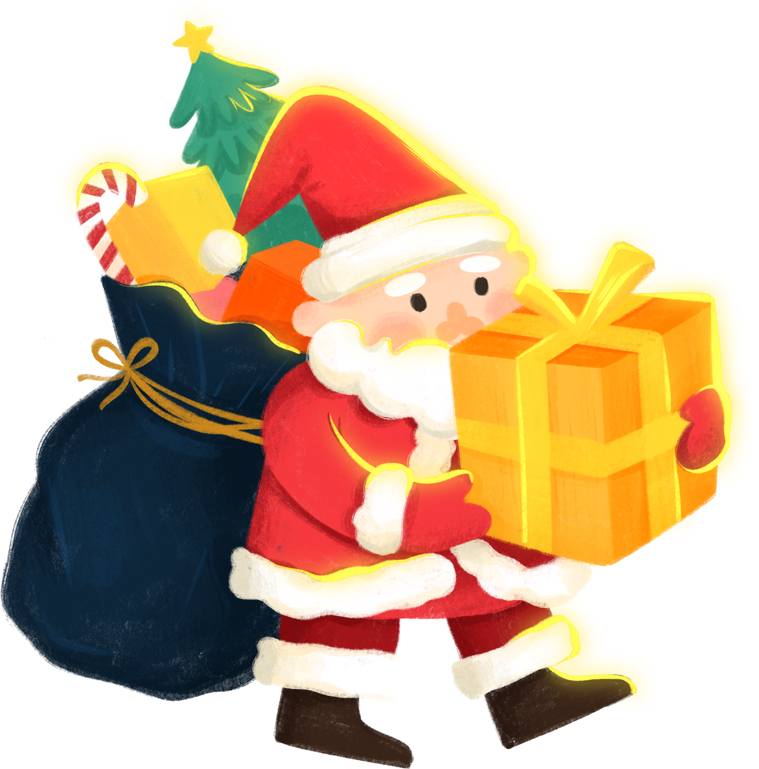
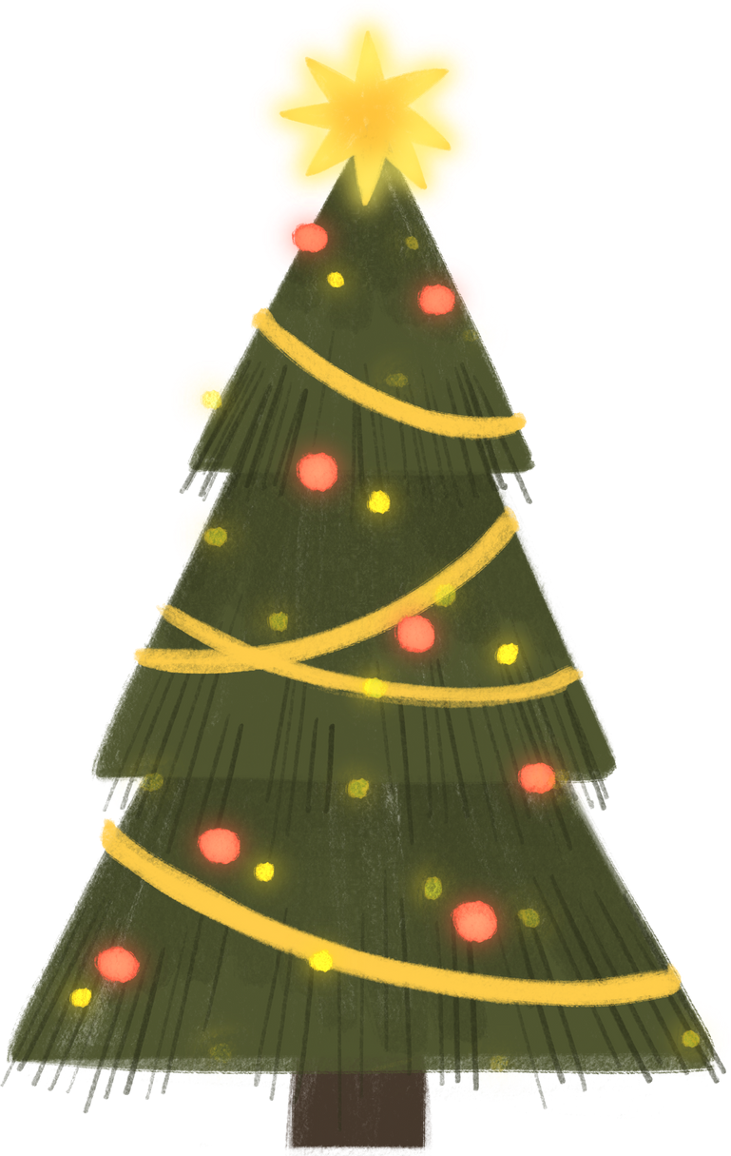

FP20 ANALYTICS CHALLENGE 22
Christmas Sales and Trends Analysis
Presented by
Kalpana S

Slide 2


ABOUT THIS CHALLENGE
What is it?
The FP20 Analytics Challenge 22 is a competition in collaboration with ZoomCharts. The challenge focuses on creating Power BI reports using ZoomCharts' Drill Down Visuals to help users explore data in an intuitive way.
What’s involved?
To participate, register for the challenge and create a Power BI report that includes at least two ZoomCharts Drill Down Visuals on a single report page.
Why Participate?
Personalized Feedback-Receive personalized feedback on your report from the ZoomCharts team to improve your skills and gain a competitive edge before the deadline.
Free License-Sign up and get a FREE Drill Down Visuals Developers License, giving you access to advanced data visualization tools for one full year.
Learning Resources-Gain access to workshops, events, and 1:1 mentorship with Power BI experts to help refine your report and enhance your skills.
Main Prize-By entering, you have a chance to win an additional $300 Amazon gift card.
e

Slide 3

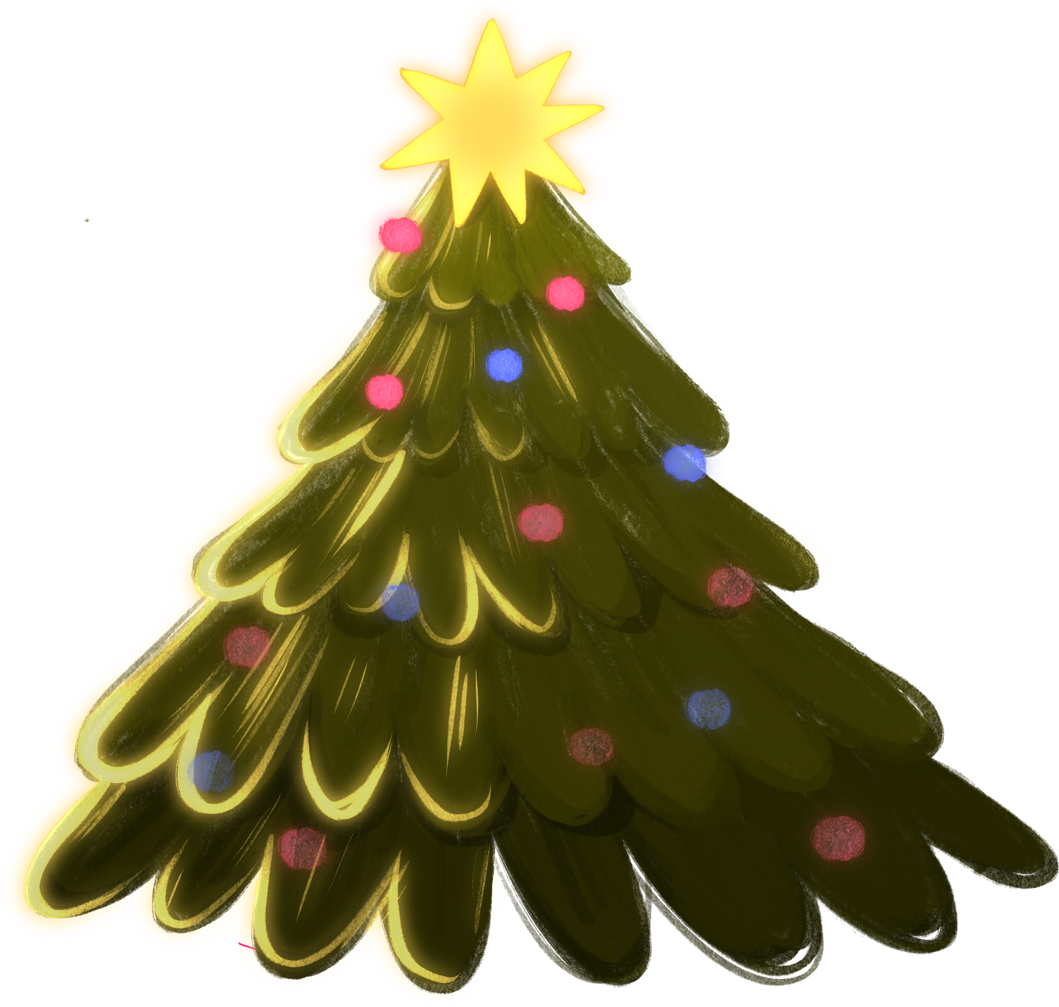
AGENDA
🔲Project Overview
🔲Key questions & Insights
🔲Live Dashboard

Slide 4
Project overview
This project leverages comprehensive data collected by a leading market research firm on holiday sales, focusing on key aspects such as customer demographics, purchase behaviors, promotional effectiveness, and satisfaction metrics. Our analysis aims to identify emerging trends in shopping habits, assess the impact of various promotions, pinpoint the key drivers of customer satisfaction, and uncover actionable insights to optimize strategies for future holiday sales.

Slide 5
Key Research Questions
&
Insights

Slide 6
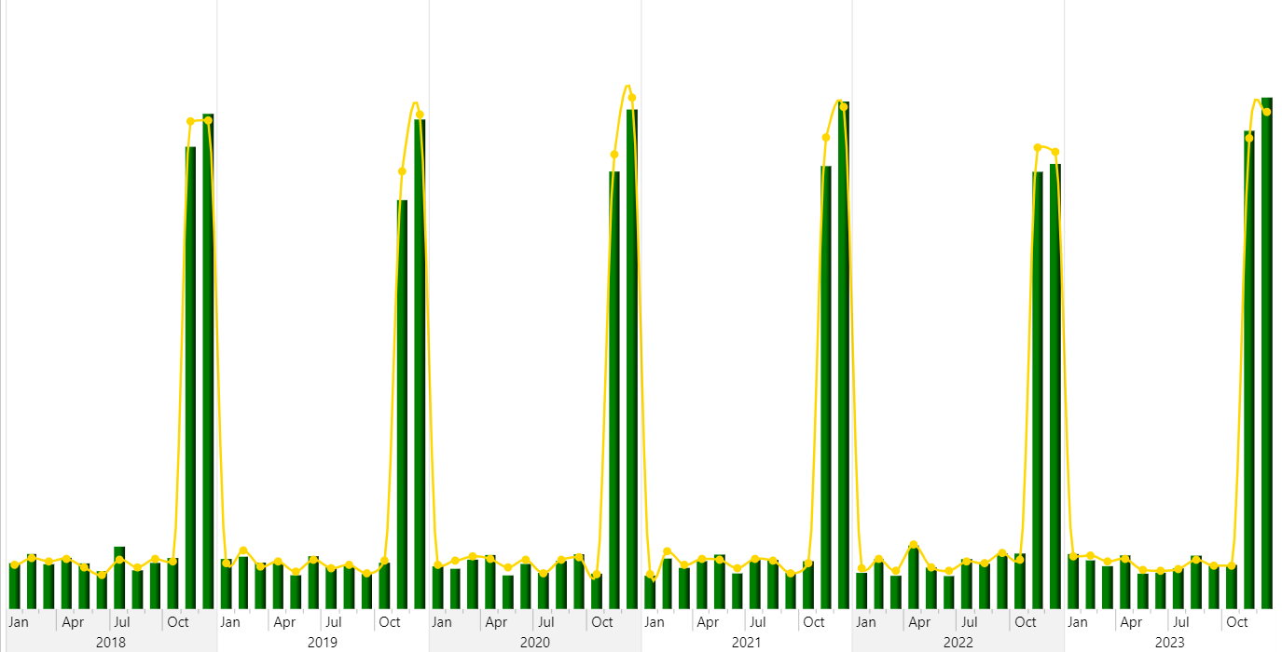
1. How do sales volumes fluctuate during Christmas compared to other periods in the dataset?
sales volumes fluctuate significantly during the Christmas period, with a substantial increase in sales during November and December compared to other periods in the dataset.

Slide 7
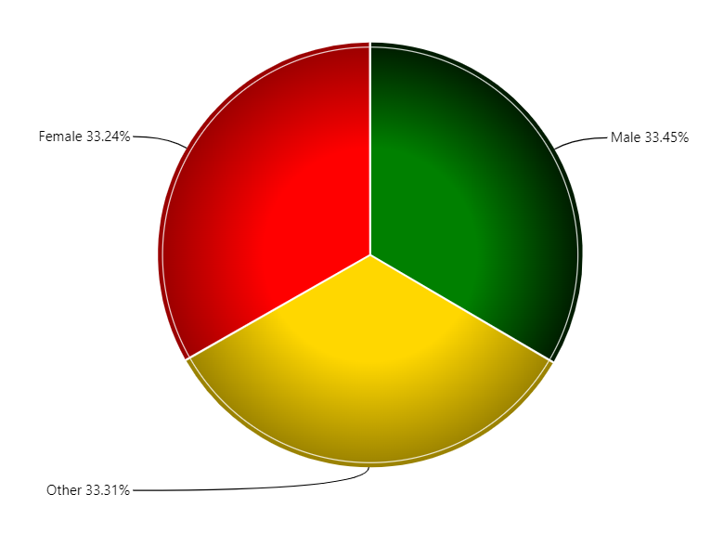
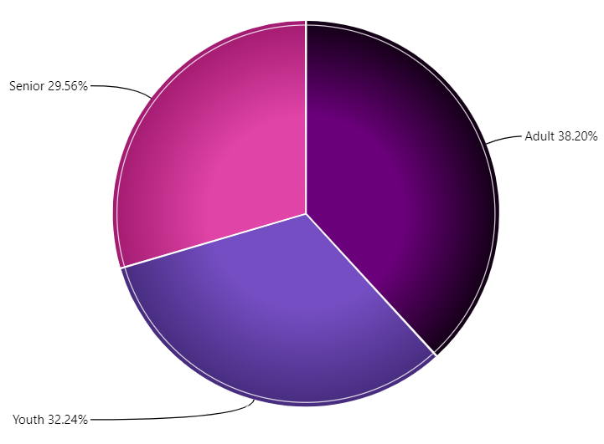
2. What are the age and gender distributions of customers making purchases during Christmas?

Slide 8
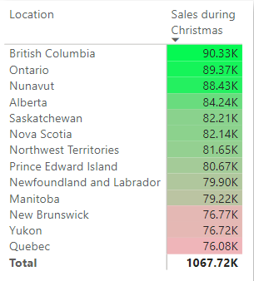
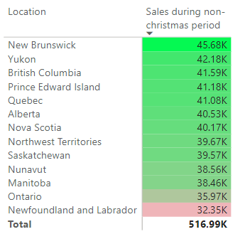
3. Which regions or cities show the highest sales volumes during Christmas, and how do these trends compare to non-Christmas periods?

Slide 9
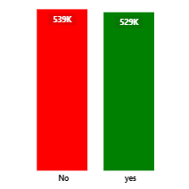
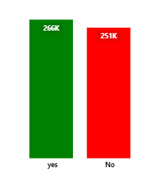
4. What is the effect of promotions on sales during Christmas? Are specific promotions more effective than others?
Christmas sales
Non christmas sales
Promotion application rates are consistent across Christmas and non-Christmas periods.
Approximately half of customers apply promotions during both periods.

Slide 10
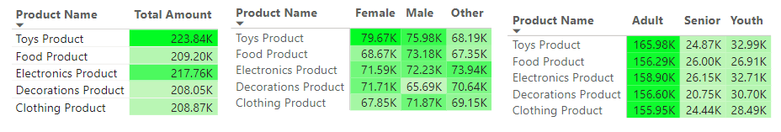
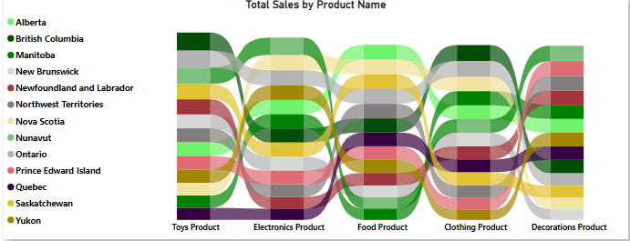
5. Which products are most popular during Christmas, and how do these preferences vary by age, gender, or location?
Toys is the most popular overall, followed by Electronics and Food.
Ontario and British columbia lead in sales across most product categories.
Youth prefer Decoration products, while Adults lean toward food and Clothing.
Females and males predominantly purchase toys, while other show a higher preference for Electronics.

Slide 11
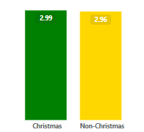
6. How do customer satisfaction scores differ for Christmas purchases compared to non-Christmas transactions?

Slide 12
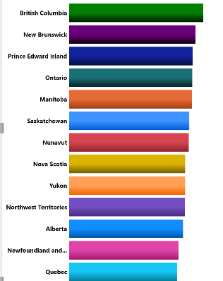
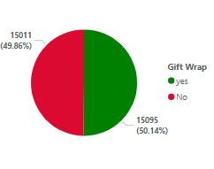
7.What percentage of orders during Christmas include gift wrapping, and which demographics are most likely to use this service?
50.14% of orders during Christmas include gift wrapping.
Customers from British Columbia, New Brunswick are the most likely demographics to use this service.

Slide 13
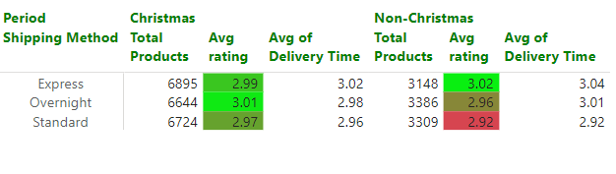
8. Are express shipping options more popular during the Christmas period? How does delivery time correlate with customer satisfaction?

Slide 14
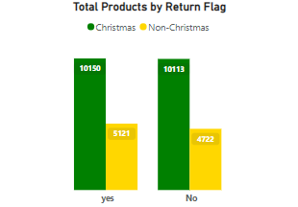
9.What are the main reasons for product returns during Christmas, and do these differ from returns during other periods?
50% of product returns during Christmas are attributed to reasons such as wrong size, damaged goods, or customer dissatisfaction.
Compared to returns during other periods, returns during Christmas may be higher due to factors like gift-related issues (wrong size, color, or model), increased gift exchanges, or delayed deliveries. These reasons are likely more prominent during the Christmas season than during non-Christmas periods, where returns might be more straightforward (e.g., due to product defects or change of mind).

Slide 15
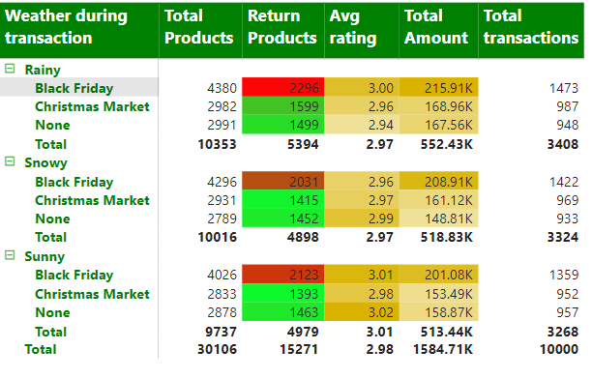
10.How do weather (e.g., snowy, sunny) or specific Christmas events (e.g., "Christmas Market") influence sales and customer behaviour?
Weather conditions do not significantly impact transaction volumes.
Sunny weather is associated with slightly higher customer satisfaction (avg rating).
Rainy days are more likely to result in product returns.
t

Slide 16

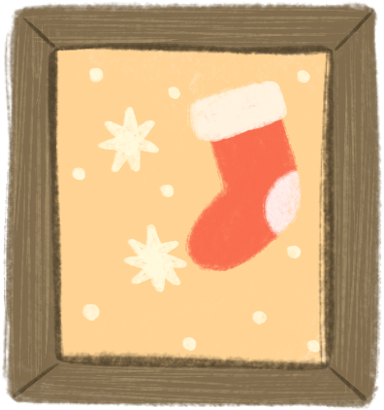
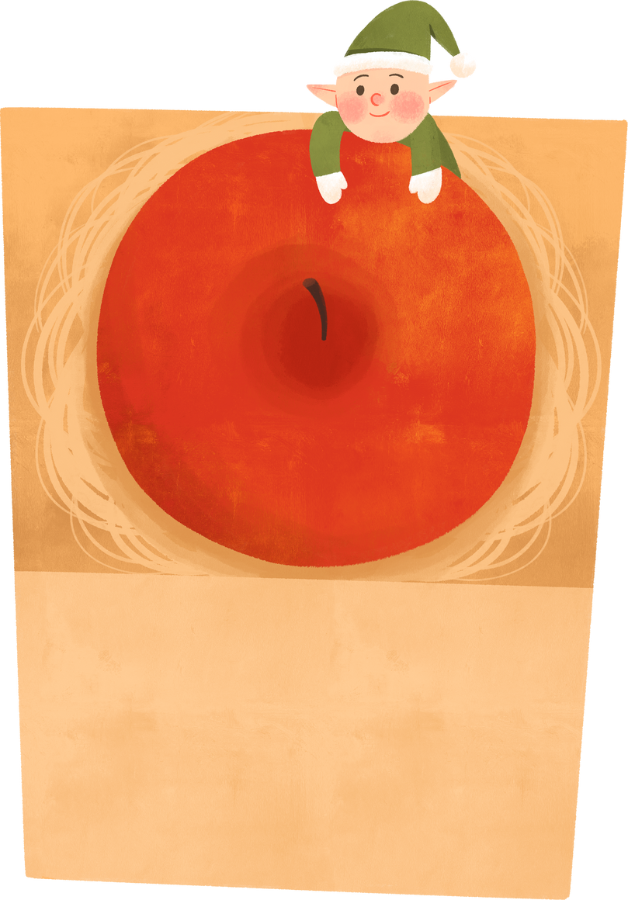
THANK YOU
MERRY CHRISTMAS
&

